Slide 1
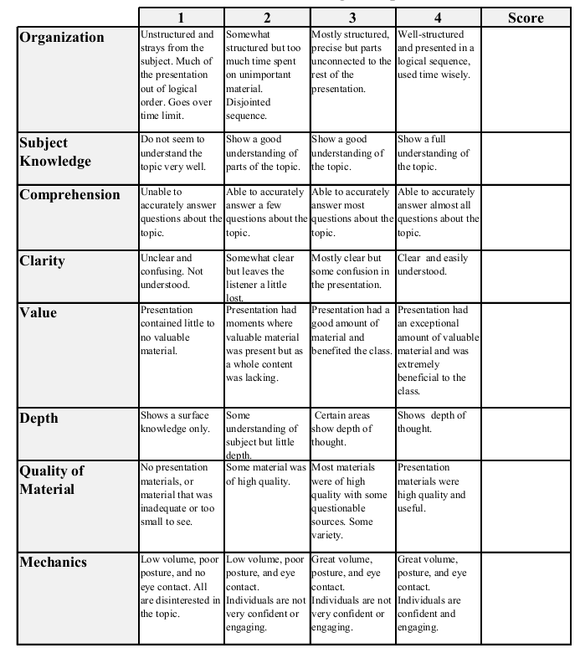
Fall 2013: Econ 339 Final Presentation
Thomas Tracy
December 9, 2014
Impact of Competition on the Nursing Homes Market
Reference: Forder, J. & Allan, S. (2014), The impact of competition on quality and prices in the English care homes market, Journal of Health Economics, vol. 34, p.73-84.
Total:_________

Slide 2
Question
What is the impact of competition on prices and quality in the English care homes market?

Slide 3
Hypotheses
H1: “In general the effect of competition on quality is ambiguous. However, there are circumstances where markets with predominantly council funding could show a negative relationship between quality and competition i.e. ∂qi∈C/∂Ni<0∂qi∈C/∂Ni<0 where C is the set of markets g where council funding dominates.”
H2: “In council-funded only markets, the impact of competition on quality works through price, and therefore ∂q_{i∈C}/∂N_{i}(p_{i}(N_{i})) = 0”
H3: “For the self-pay market, we cannot sign the differential qNs. However, we do expect that qNc≠qNs.”
H4: “For the whole market we hypothesise that pN*<0. This is a standard result where prices are set by providers or follows from our definition of pc=ρ(Nc,q_) when prices are set by the public authorities.”

Slide 4
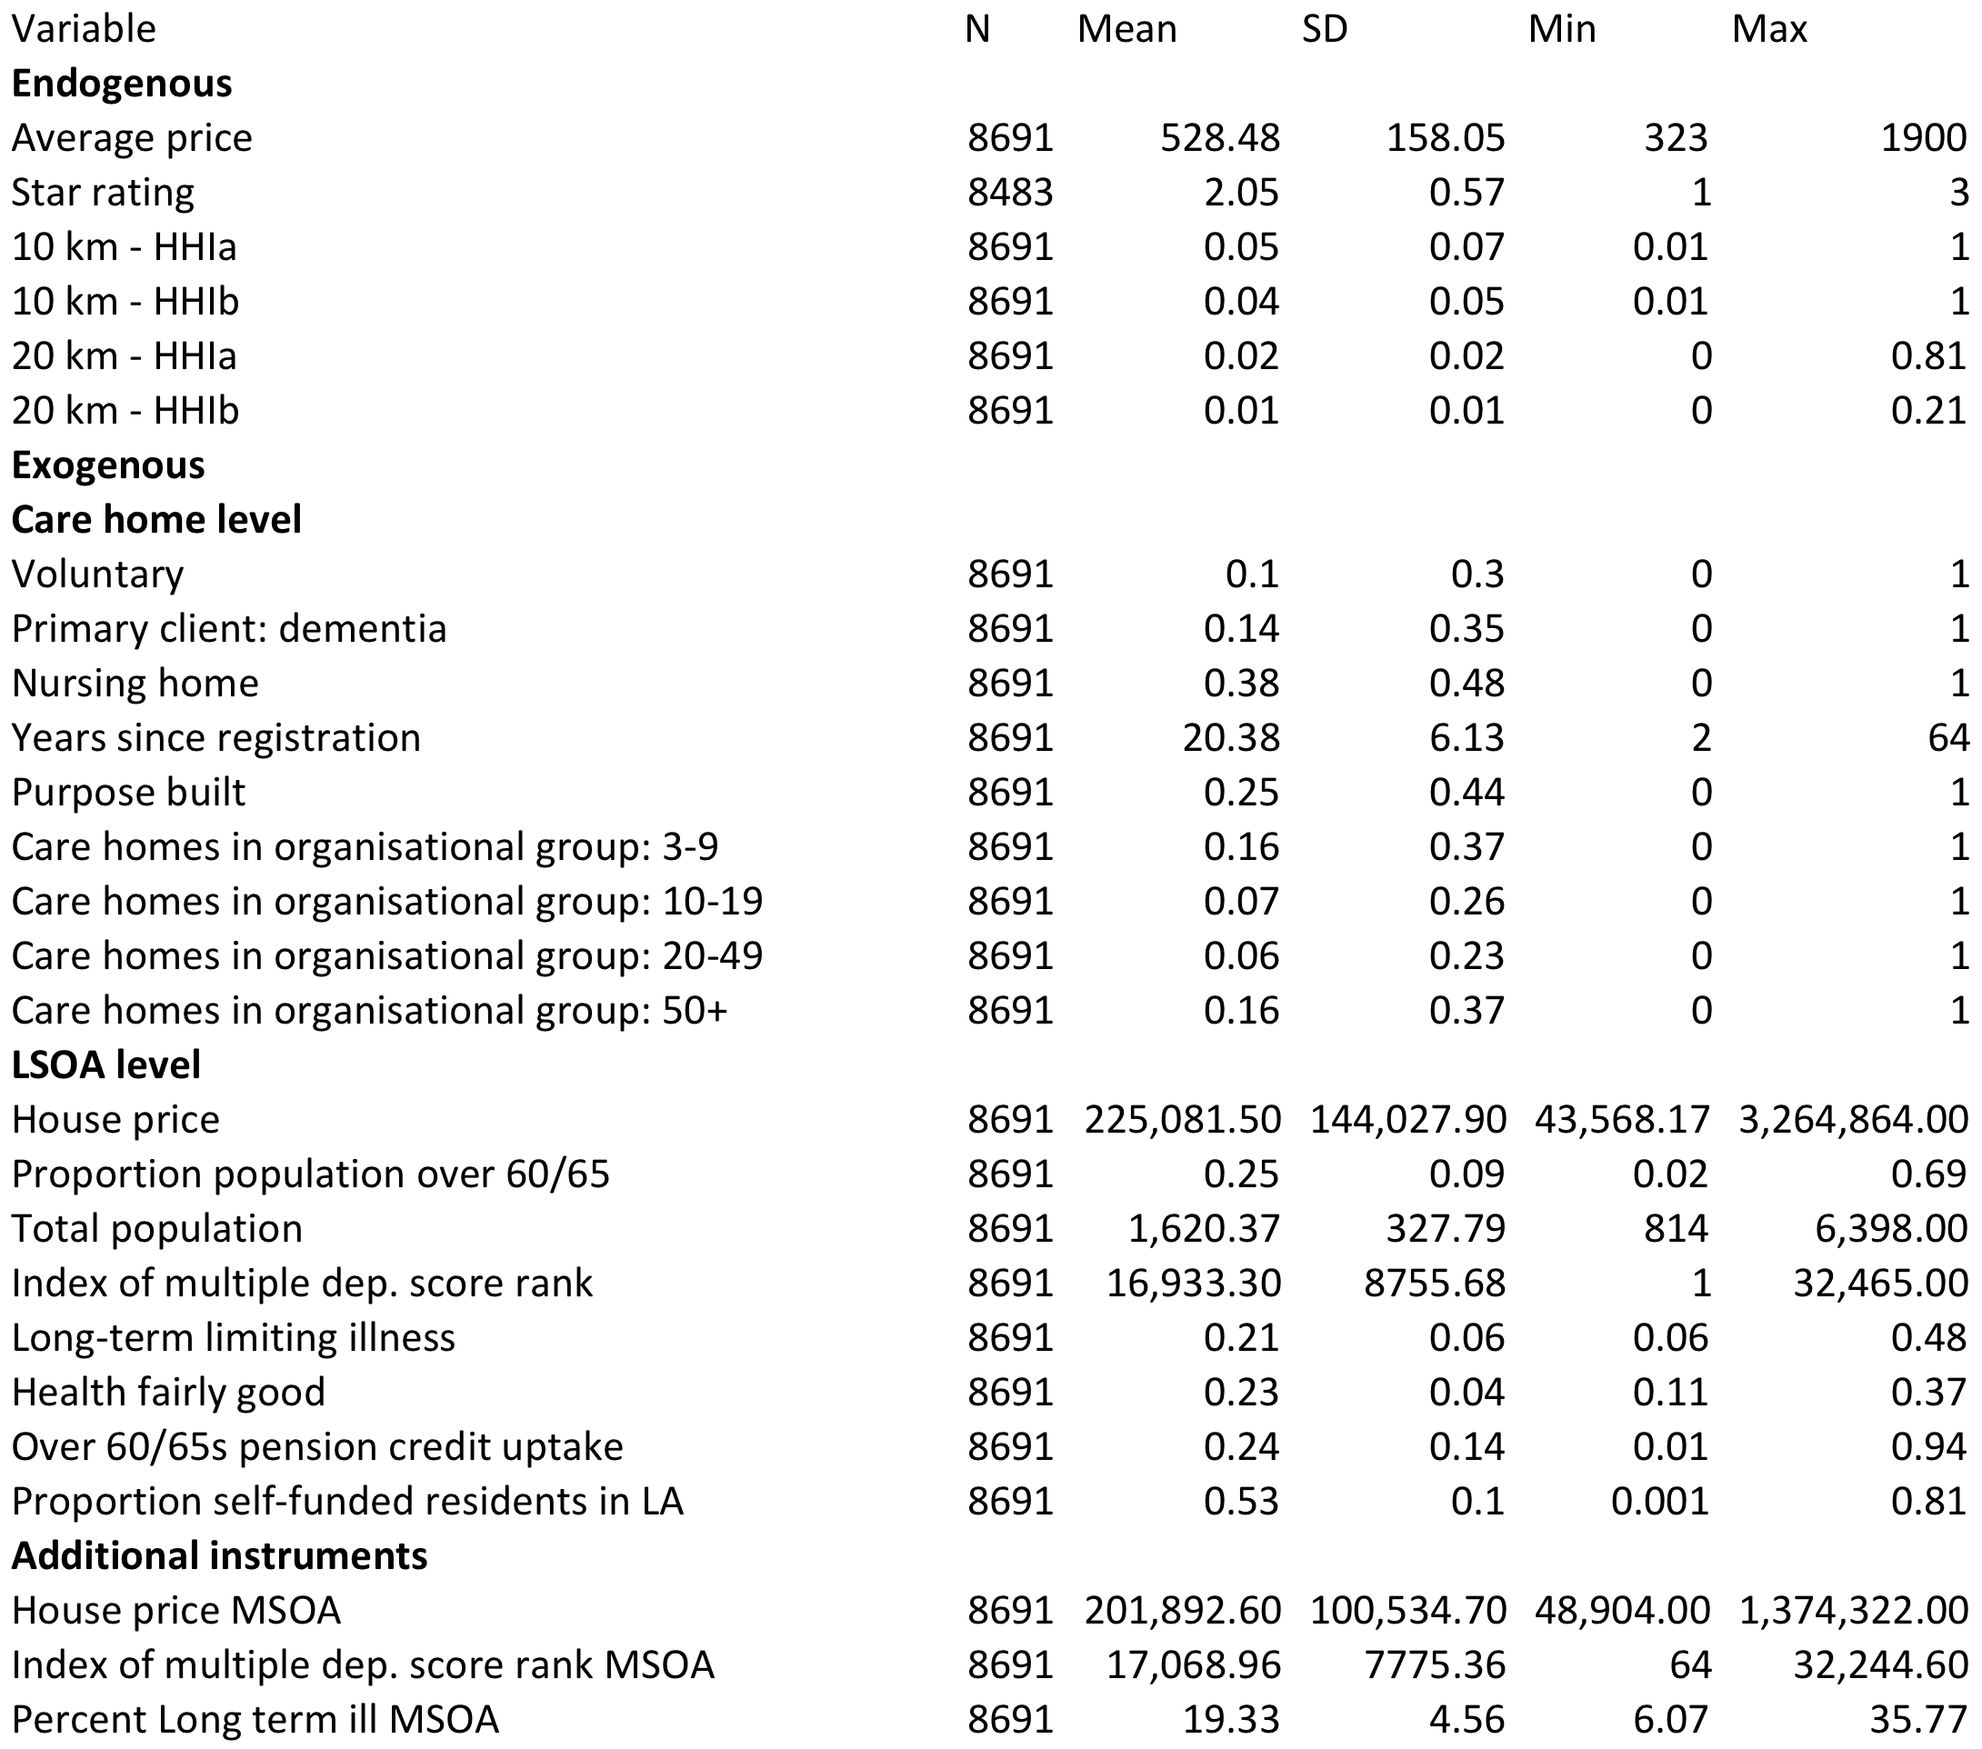

Slide 5
Characteristics of the Care Market
Monopolistic Competition
We know that increases in competition can have ambiguous effects on quality
Demand for care home services is influenced by the level of disability and ill-health in the population and by the wealth of potential service users
Two Groups: publicly-supported and self-payers
In 2010, 40% of care home residents were self-paid

Slide 6
Data Set
Price data comes from the Laing & Buisson Care Homes Contacts dataset from July 2010 - contains info on all care homes in England
The Care Quality Commission set from September of 2010 - contained 10,470 registered care homes for the elderly
A match was done between these two sets to determine the final dataset of 10,302 care homes in England that would be used in the study

Slide 7
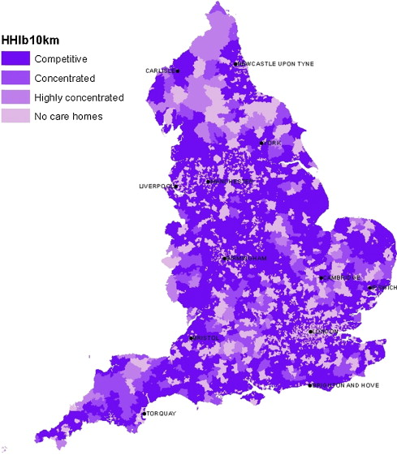
HHI < .10
.10 < HHI < .20
HHI > .20
The market size is defined by a radius of 10 km
4,152 out of the 4,588 zones where care homes are are located are considered to be competitive (90.50%)
Zones are Medium-level Super Output Areas (MSOA’s) as determined by the Office of Fair Trading

Slide 8
Results
Study found that quality was positively related to concentration i.e. negatively related to competitiveness
Competition caused decreases in prices
Price elasticity= 0.22 at the mean level of competition

